Slide 1
Proxy Design Pattern
By Ezell Frazier

Slide 2
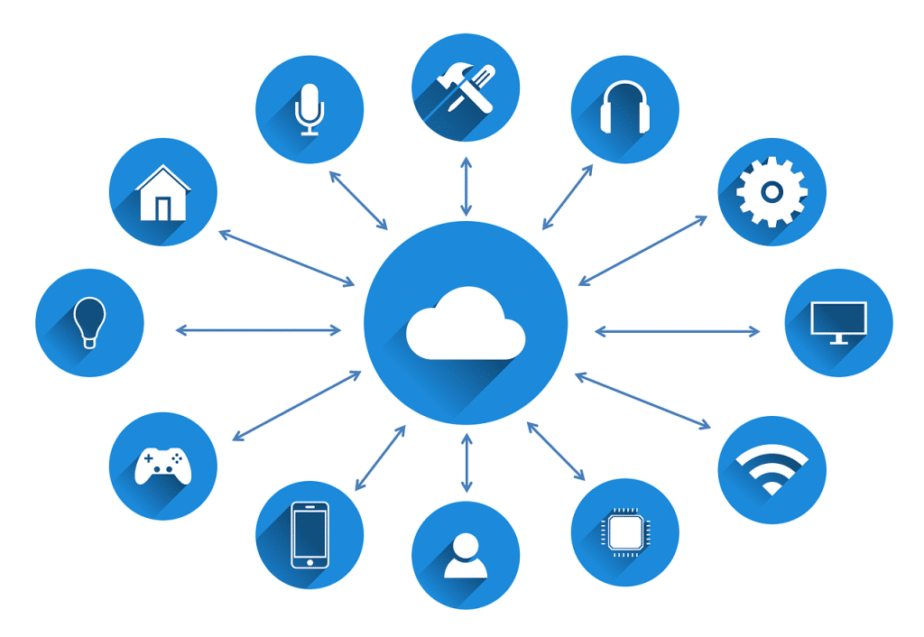
Overview
Problem: “Server-less” computing
How can solve this?
Implementation: Proxy Pattern
Proxy design pattern; by definition
Other Use-Cases
Conclusion

Slide 3
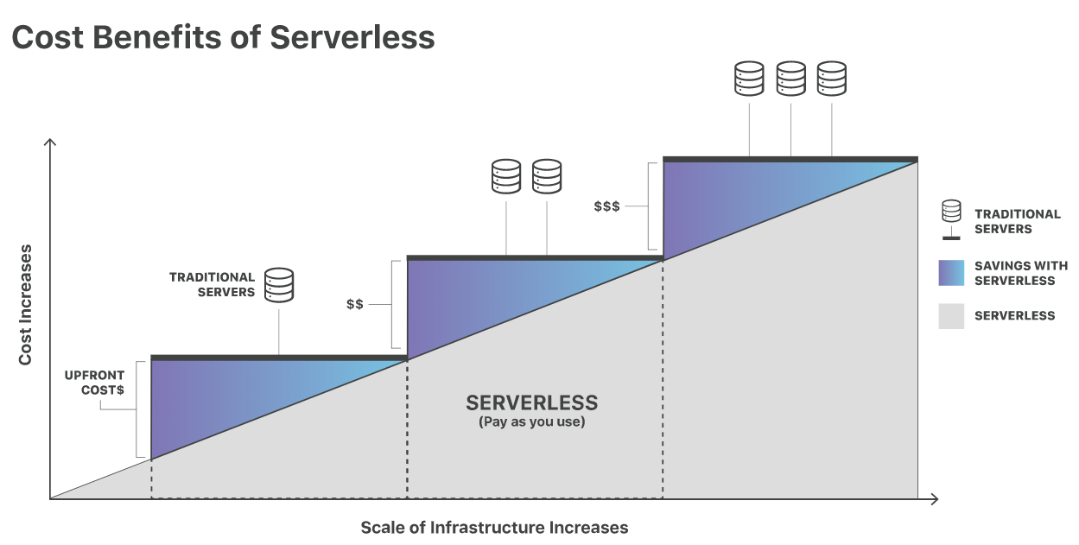
Problem: “Server-less” Computing

Slide 4
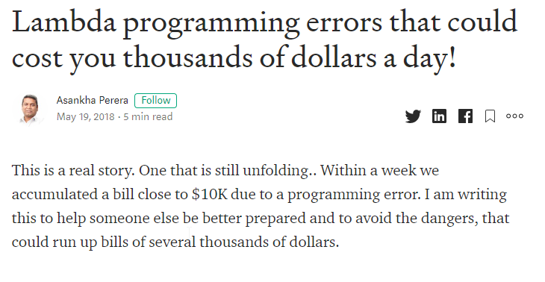
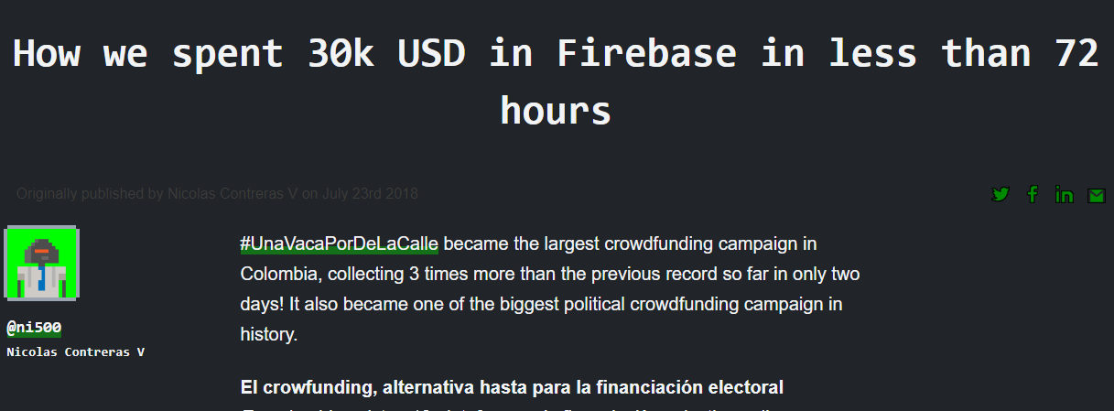
Problem: “Server-less” Computing

Slide 5



Recap: “Server-less” Computing Concerns
Pay-as-you-go instead of monthly
Bugs or logical errors can rack up big bills
Another issue: cold-starts
The “server” needs to boot-up after being too idle
The some invocations can take longer than others
Hidden cost:
Users are billed per function invocation if execution time is below billable threshold

Slide 6
How can we mitigate some downsides?
Function Memoization/Caching
Prevents unnecessary calls to the cloud
Mitigates cold-boots
Input validation
Also prevents unnecessary calls to the cloud

Slide 7
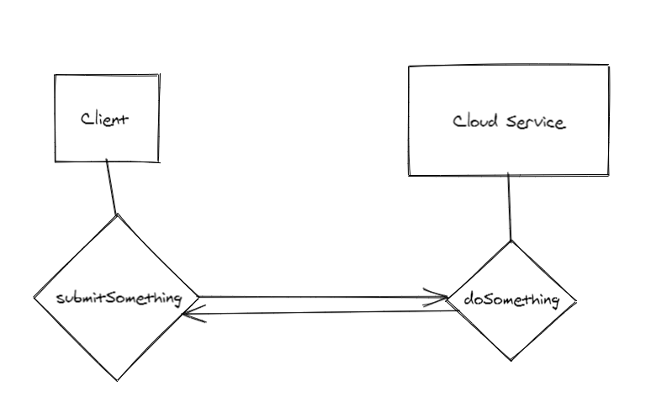
Current Implementation

Slide 8
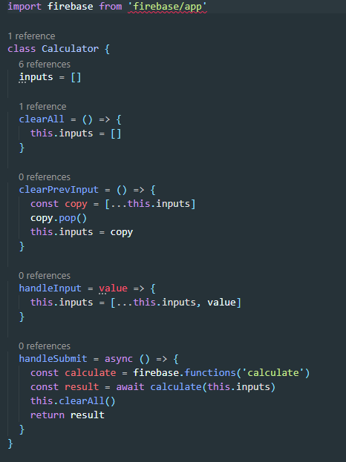

Slide 9
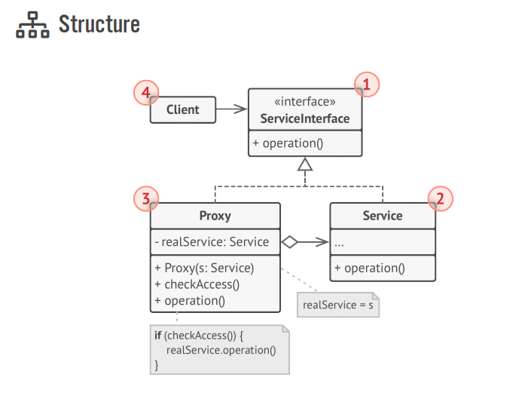
Proxy Design Pattern
The client creates two objects, Service and Proxy
The Proxy initializes with the Service as an argument
The Proxy manages the Service’s lifecycle with added functionality

Slide 10
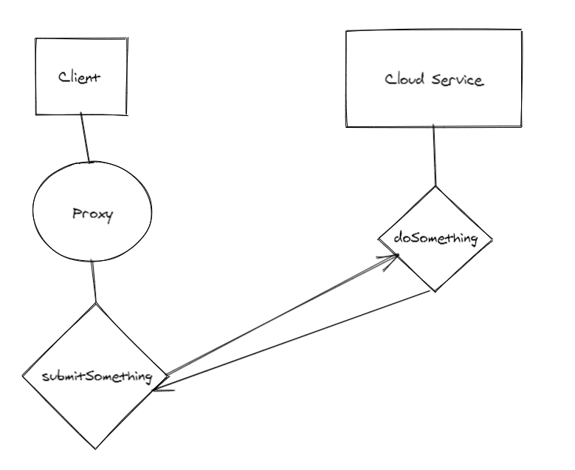
Refactored Implementation

Slide 11
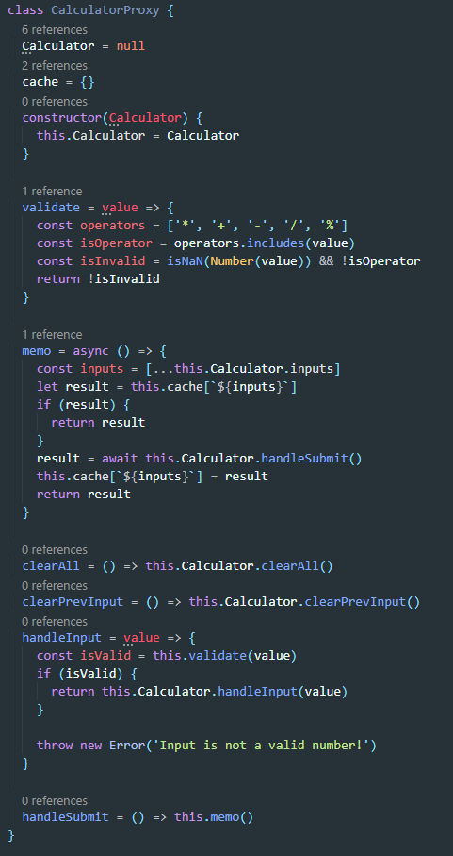

Slide 12

Why Proxy and not another Pattern?
The Adapter returns a different interface for an object
The Facade also returns a different interface for an object, may contain other objects
The Decorator does not manage the lifecycle of the object passed into it.

Slide 13
Conclusion/Questions?
Other Use-cases
Lazy initialization of heavy/resource intensive objects
Access Control
Logging

